Slide 1

Quorum Public Transaction
1

Slide 2

Public Transaction
Transactions payload is visible to all the participants of the same Quorum network.
They are created as per the standard of Ethereum transactions.
Ethereum transaction supports three types of transactions:
Ether transaction from one party to another.
Creation of a smart contract.
Transacting with a smart contract.

Slide 3
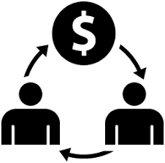
Components of Public Transaction
Address: Destination wallet address.
Data (EVM Bytecode): Hex formatted, compiled smart contract creation code.
Value (Ether): Amount of Ether you wish to deposit in the smart contract.
GAS Price: Amount prepared in Ether per unit of gas
GAS Limit: The total amount of gas spent on the transaction execution.

Slide 4











How Pubic Transaction is Committed?
Transaction of Ethers
Ethereum Client
Send
Transaction
Accept
Transaction
Signed Transaction
Contract Creation
Transaction
Ethereum Client
Ethereum Client
Contract Transaction
Sign using Wallet
private Key
Reject Transaction
Ethereum Client
Transaction Manager
Transaction status
Transaction Receipt

Slide 5
THANK YOU!

